Slide 1
General Guideline
© (2021) ABES Engineering College.
This document contains valuable confidential and proprietary information of ABESEC. Such confidential and proprietary information includes, amongst others, proprietary intellectual property which can be legally protected and commercialized. Such information is furnished herein for training purposes only. Except with the express prior written permission of ABESEC, this document and the information contained herein may not be published, disclosed, or used for any other purpose.

Slide 2
Session Plan - Day 3
3.2 List
Creation
Accessing
Updation
Review Questions
Practice Exercises

Slide 3
List
.
Python List is the most commonly used sequence.
Important points about list are as follows.
List elements are enclosed in square brackets [] and are comma separated.
List is the sequence of class type ‘list’.
List can contain elements of different data types.
List is a mutable(changeable) sequence, would be discussed in detail in 3.2.3
List allows duplicate elements.
List elements are ordered, it means it give specific order to the elements, if new element is added, by default it comes at the end of the list.

Slide 4
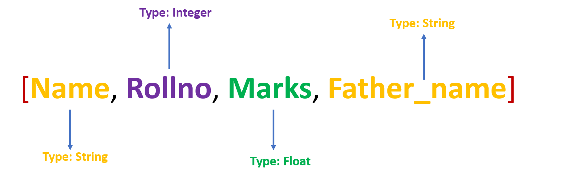
List
Real World Scenario:
List is used when there is a possibility of elements of different data type.
For example record of a particular student, having name as string, roll.no as integer, marks as float, father’s name as string.
To contain this record list is the appropriate sequence.
List Representation

Slide 5
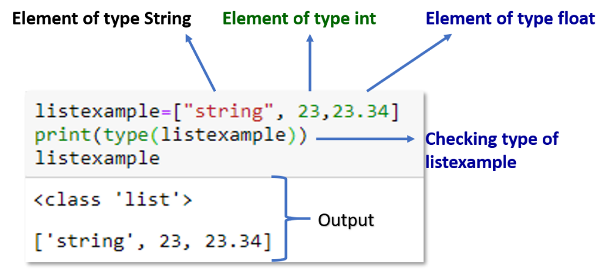
List Example
In this example a variable named list example has been created and three elements have been assigned.
As we have enclosed elements in square brackets, this makes list example is of type list.

Slide 6
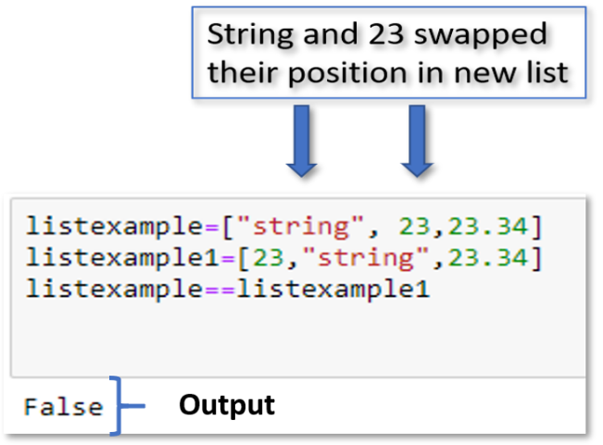
Ordered Property of List
Ordered sequence of the list means the order in which elements appear is unique
The position of every element is fixed.
If we change the position of any element, then list would not be the same anymore.

Slide 7
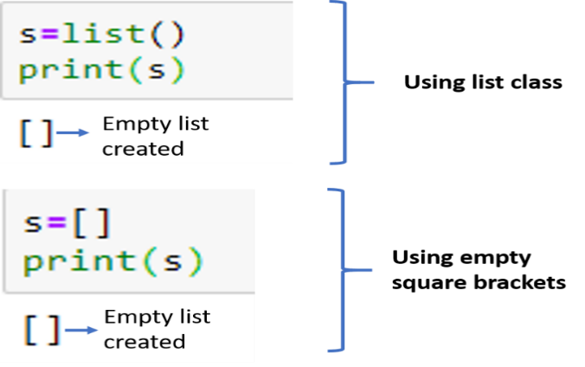
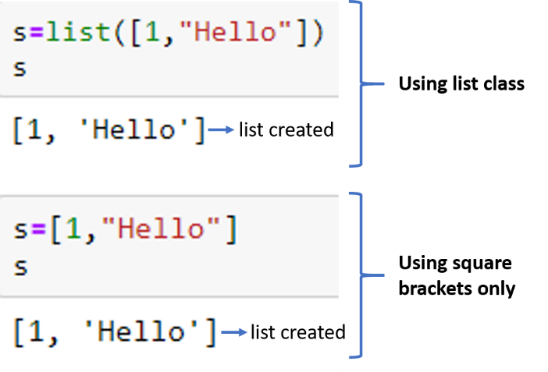
Creation of List
List can be created by many ways as follows.
Creation of Empty List
Creation of Non Empty List

Slide 8
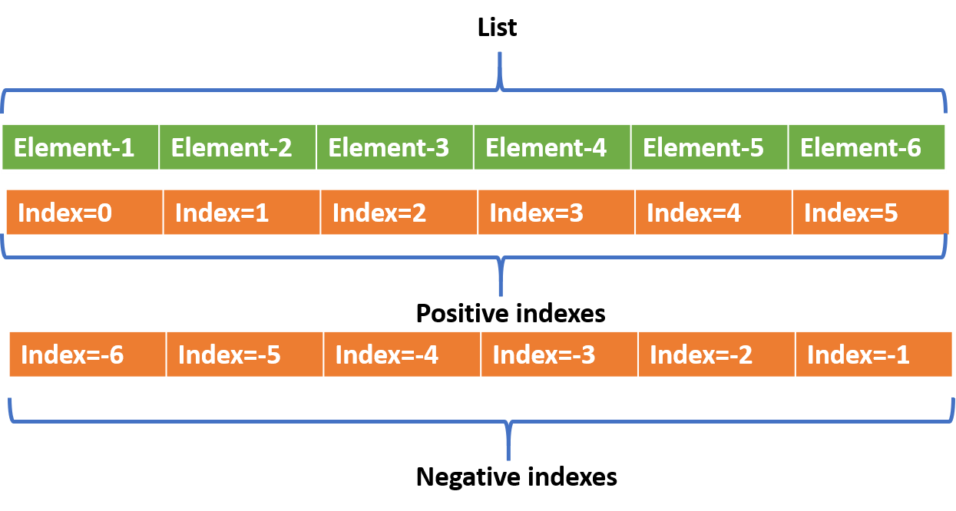
Accessing the List
Indexing the List
In the list index are started from 0, it means first element takes 0 index and it increases like 0,1,2…(n-1).
List also supports negative indexing.
It means last element can be accessed using -1 index, second last as -2 and so on.

Slide 9
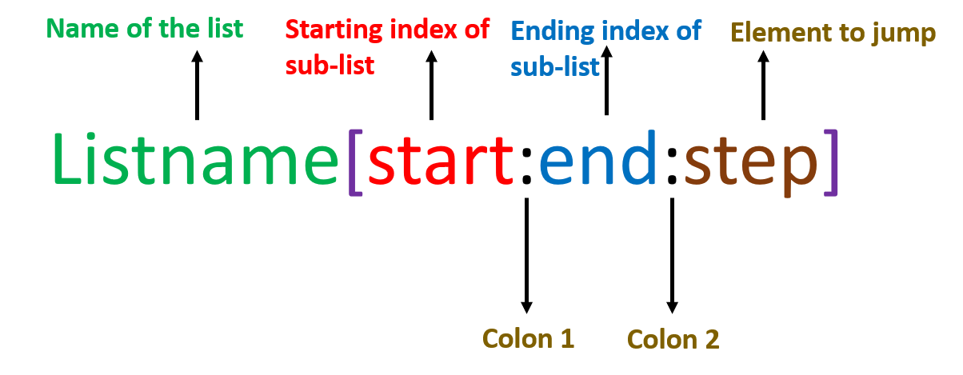
Slicing
Slicing is used to get substring from a string.
We use Slice operator in the list to get a sub list.
Start= Optional argument by default value is 0.
End = Optional argument by default value is number of elements in the list. If any number given, then value is taken as number-1.
Step=Options argument by default value is 1.
Colon 1: Required
Colon 2: Optional

Slide 10
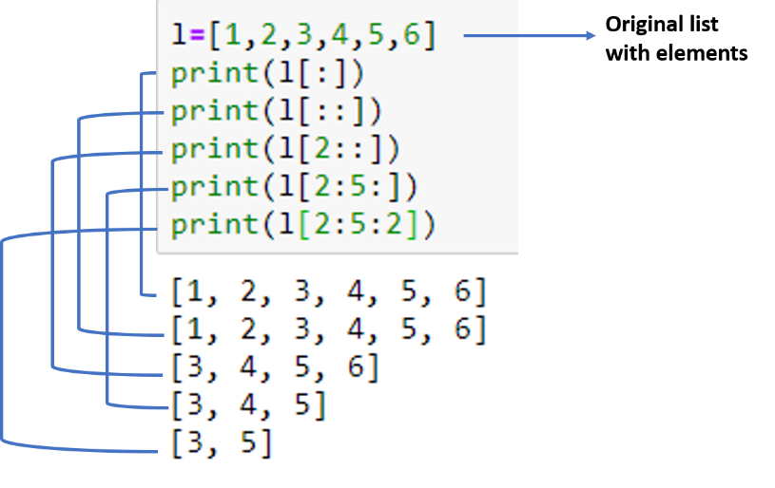
Slicing Example
Single colon[:]- It is used to print the entire list.
Double colon[:]- It is used to print the entire list.
l[2::]-It is used to print the list starting from index 2 till the last element of the list.
L[2:5:]- We have set start and end both as 2 and 5, so it’s starting from 2 and ending with (5-1) and printing values for indexes 2,3 and 4 index.
L[2:5:2]-end and step has been set as 2,5 and 2. So output substring starting from index 2, ending with 5-1=4 and step counter is 2, so its skipping alternate element.

Slide 11



Examples of List Slicing
Operator | Explanation | Example
[:] | This gives a complete original list
[1:3] | It starts with 1th index and ending with (3-1=2) index
[2:] | Sub list starts with index 2 and ends at last element as nothing specified on right side of the colon

Slide 12



Examples of List Slicing
Operator | Explanation | Example
[1:4:] | Start=1, stop=4 and by default step=1.
[1:4:2] | Start=1, stop=4 and by step=2. As the step is 2, it took every 2nd element.
[::-1] | Starting is 0th index and stopping at last index and step is negative count so that it would print in reverse order

Slide 13
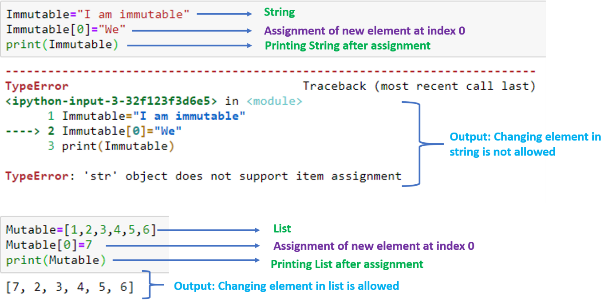
Updation in List:
List updating involves insertion of new elements, deletion of elements or deletion of complete list.
List is a mutable sequence it means it allows changes in the elements of list.

Slide 14
Updation in List:
List updating involves insertion of new elements, deletion of elements or deletion of complete list.
List is a mutable sequence it means it allows changes in the elements of list.

Slide 15
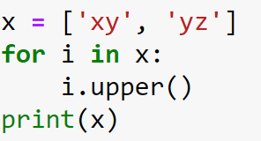
Can you answer these Questions
1.What is the output of the following code?
A.[‘XY’,’YZ’]
B.[‘xy’,’yz’]
C. None of the above
D. Both of the above

Slide 16
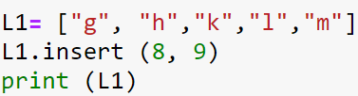
Can you answer these Questions
2.What is the output of the following code?
[‘g’,’h’,’k’,’l’,’m’]
B. [‘g’,’h’,’k’,’l’,’m’,9]
C. [‘g’,’h’,’k’,’l’,’m’,8,9]
D. [‘g’,’h’,’k’,’l’,’m’,9,8]

Slide 17
Session Plan - Day 4
3.2 List
Updation in List
Operations in List
Built in Methods
Operations
Loops
Nested list
List Comprehension
Review Questions
Practice Exercises

Slide 18
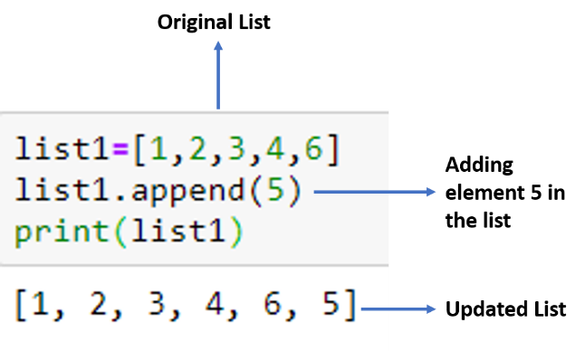
Add new element in List:
We can add elements to the existing list using append function.
Append function always add the element at the end of the list.
Syntax:
Listname.append (element to be added)
In this example element 5 has been appended in the originally existed list. It’s being added in the last

Slide 19
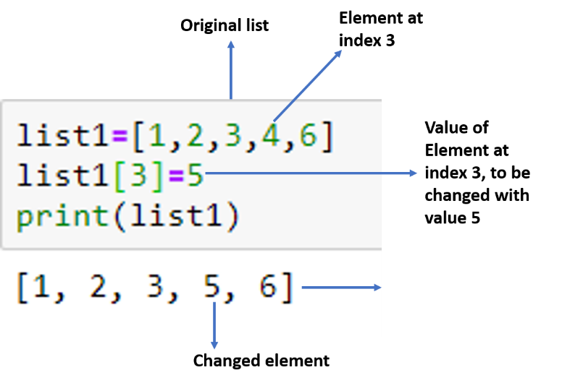
Changing new element in List:
Value of the element at index 3 has been assigned new value as 5, so element in the output list is changed from 4 to 5.

Slide 20
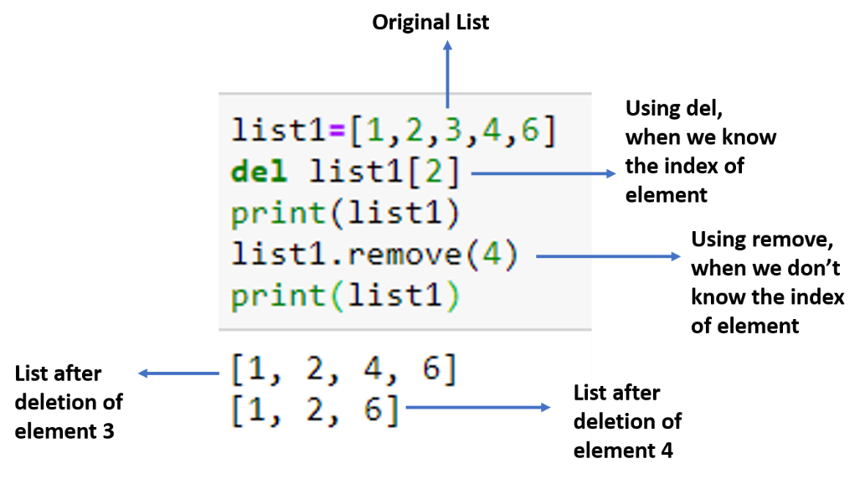
Deletion in List:
List elements can be deleted.
Using del command If we know the position(index) of the element which is to be deleted.
We can use the remove method by giving the specific element as given in the example If we know the position(index) of the element.

Slide 21
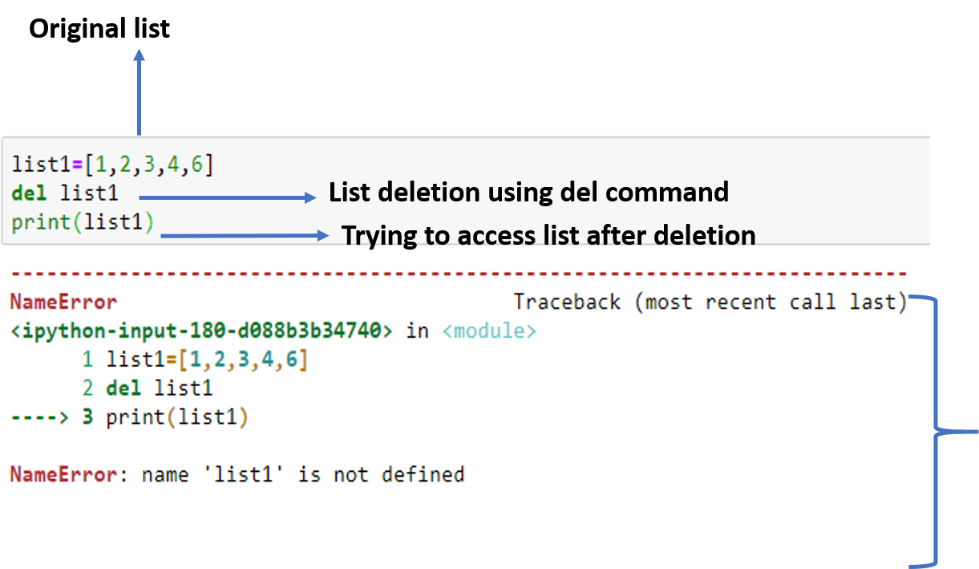
Deletion in List:
list1 has been deleted and then we are trying to print it and its giving error because it does not exist now.

Slide 22




Built in Methods in List
Method | Remark | Example
len() | It calculates the length of the list or the number of elements in the list.
max(list) | It returns the maximum element from the list
min(list) | It returns a minimum element from the list
list(seq) | It converts into any sequence into a list

Slide 23
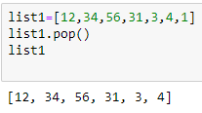

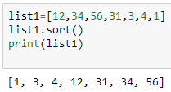
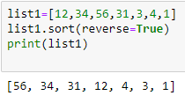
Contd..
Method | Remark | Example
pop() | It deletes the last element from the list Note – We can also pass index as argument in pop() to delete a specific index value.
count() | It counts the occurrences of a particular element in the list
sort() | Sort the elements of the list in ascending order
reverse() | Sort the elements of the list in reverse order

Slide 24
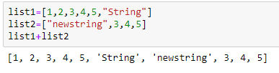
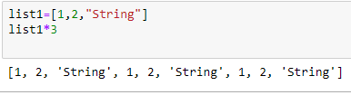
Operations on List
Python supports variety of operations on the list
Operation | Remark | Example
Concatenation | Operation adds two list elements
Repitition | It repeats the list specified number of times

Slide 25


Contd..
Python supports variety of operations on the list
Operation | Remark | Example
Membership | To check whether an element belongs to the list or not
Membership not | I return true of an element that does not belong to the list

Slide 26
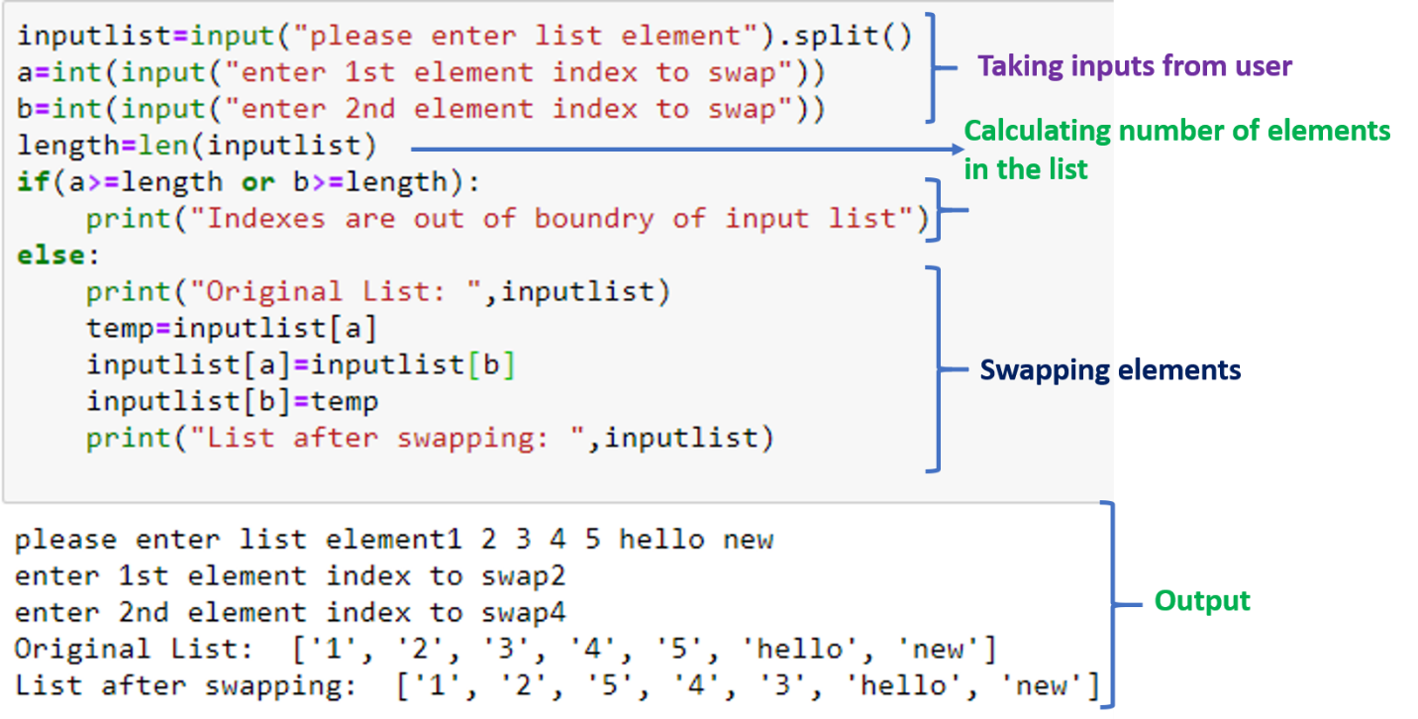
Example
Write Python Program to swap elements in the list.

Slide 27
Practice Problems
Take a list input from user having integer elements and calculate sum and average of the list.
Take an input list and swap string elements of the list with empty string.

Slide 28
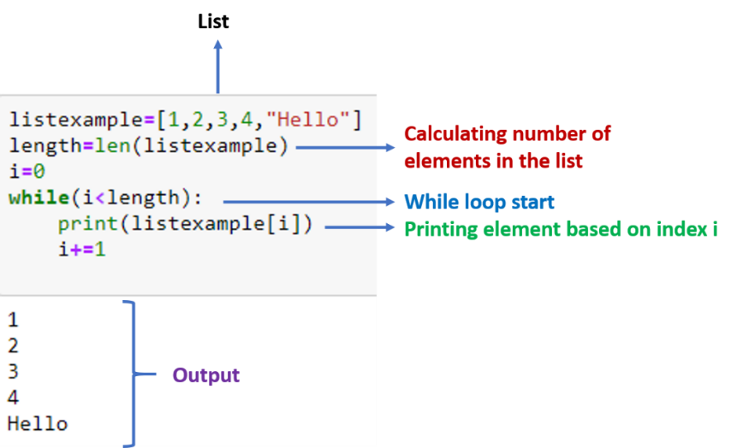
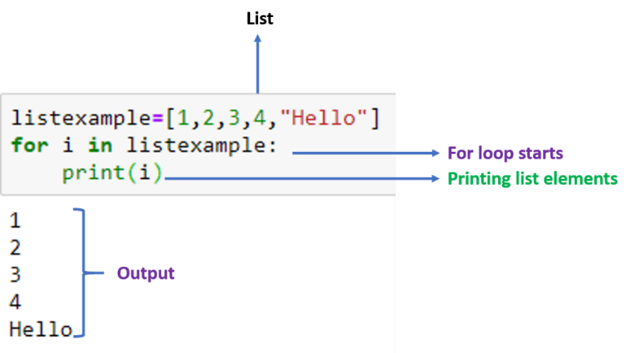
Loops with List
While loop with list
For Loop with list

Slide 29
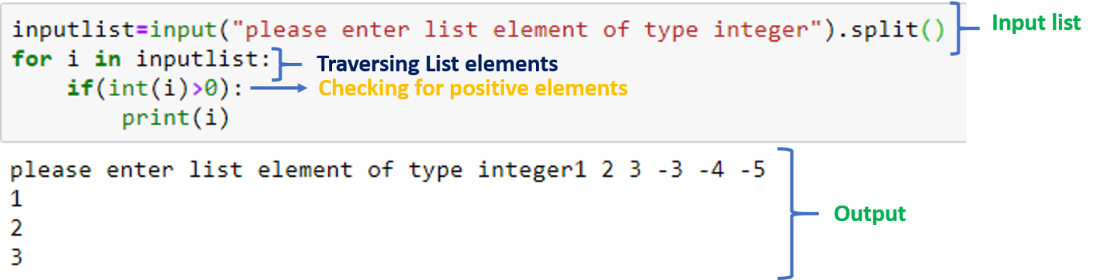
Example
Write a python program to print all positive number of a list.
Practice Exercise:
Write a python program to remove duplicate from the list.
Write a python program to count positive, negative and string type elements.

Slide 30
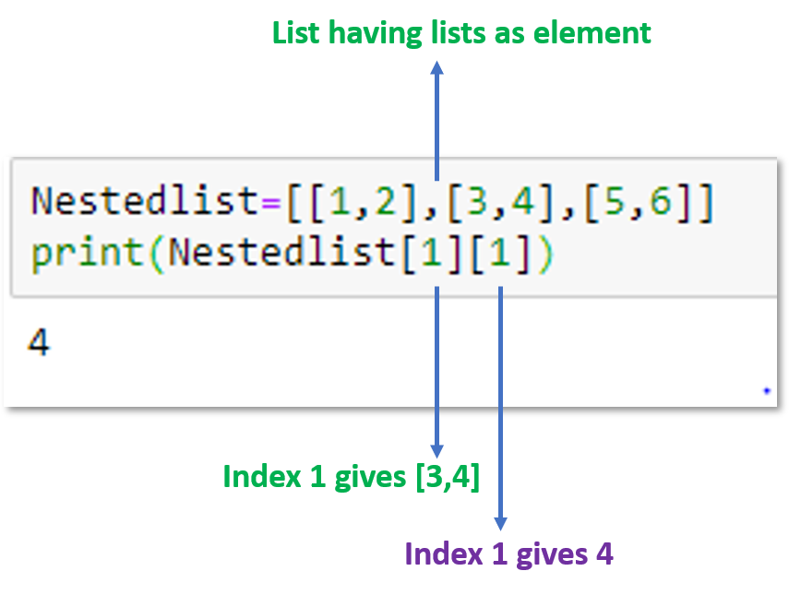
Nested List
When we have an element of a list in the form of the list itself, it is called Nested List.
Elements of the nested list can be accessed using the 2-D indexing access method.
.
In this example, first [1] denotes [3,4] and second [1] represents 4, so it gives output as 4.

Slide 31
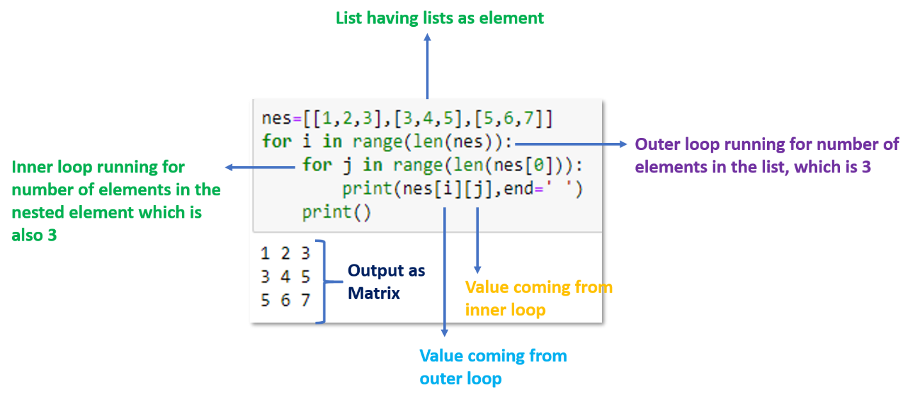
Nested List as a Matrix
We can represent nested list as matrix also.
For this we would use nested for loop.
Outer loop would run for number of elements in the list and inner loop would consider individual element of the nested list as a list.
.
.

Slide 32
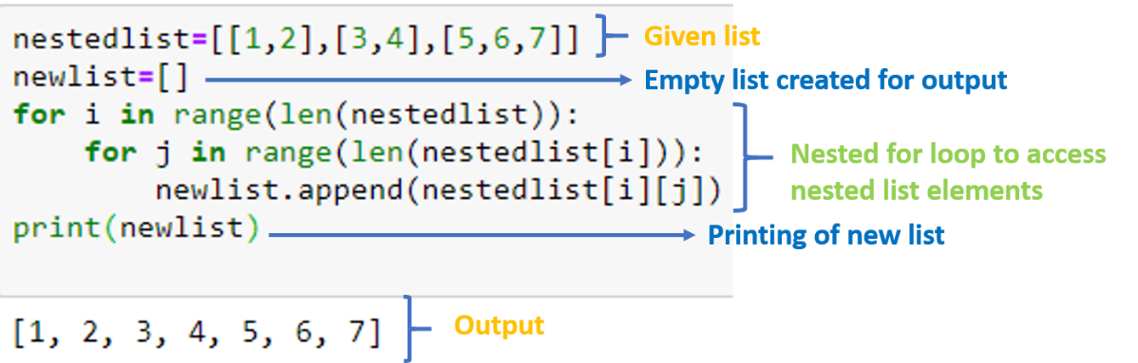
Example
Create a flat list from a nested list.
.
Practice Exercise:
Using nested list print transpose, of a given matrix
Print reverse order of a nested list
.

Slide 33
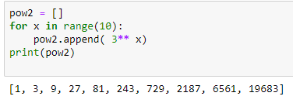
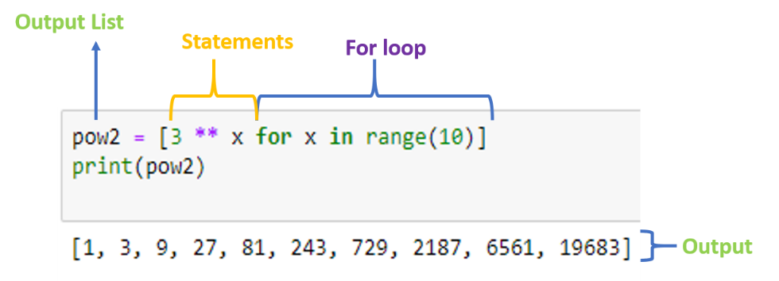
List Comprehensions
Let's suppose we want to write a program to calculate powers of 3 for a given range.
Traditional Programming
Python provide us writing iterative programs in much lesser lines called List comprehension.
The same problem has been solved using list comprehension.
.

Slide 34
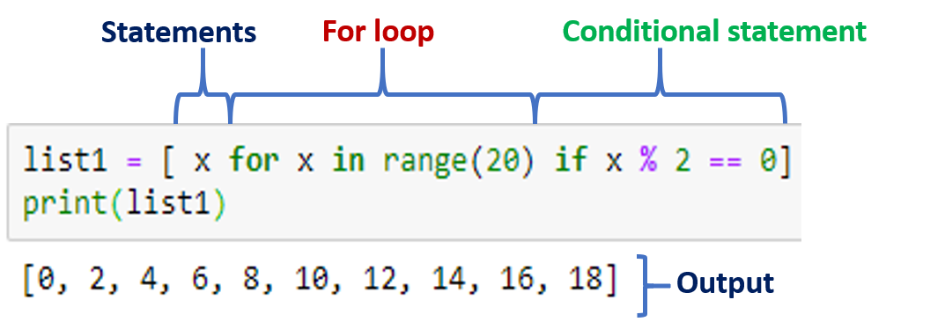
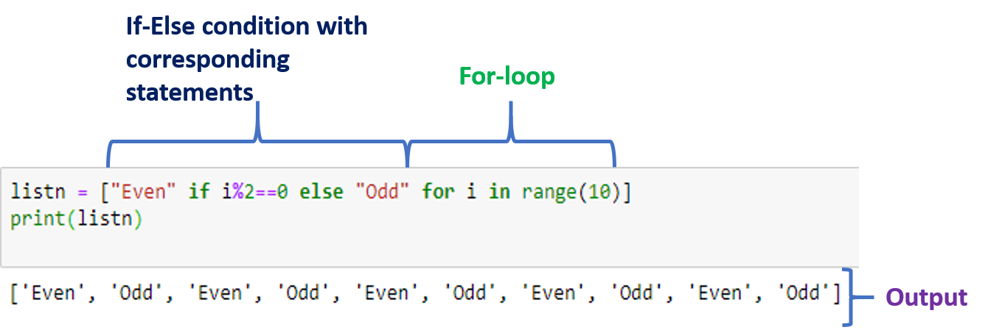
List Comprehension
Syntax:
[ statements for an item in list ]
IF ELSE :
We should notice one change that because in if-else case output is separated based on the condition.
if-else and conditions has been written along with statements.
We have the facility of adding conditionals in the list comprehension.
.

Slide 35

Can you answer these questions?
1. What will be the Output of the following code?
A.[0,1,2,3,4,5]
B.[0,1,2,3,4,5,6]
C.[0,1,2,3]
D. None of the Above
.

Slide 36

Can you answer these questions?
2. What will be the Output of the following code?
A. [5,7,9]
B.[3,4,5]
C.[6,7,8]
D.[9,10,11]
.

